Slide 1
TABLE OF CONTENTS:
Overview (Pad Modes)
Overview (Jog Screens)
Overview (Decks)
Overview (Mixer)
MixerFX and Beat FX
Loop section
Beatjump section
Sync modes
Deck Layout
Browser
Transport
Beatgrid
Settings
Pad hotcues
Pad padFX/Rolls
Pad macroFX/mixerFX
Pad jogFX
Pad keyboard
Pad beatjump/loop
Pad slicer
Pad remix decks

Slide 2
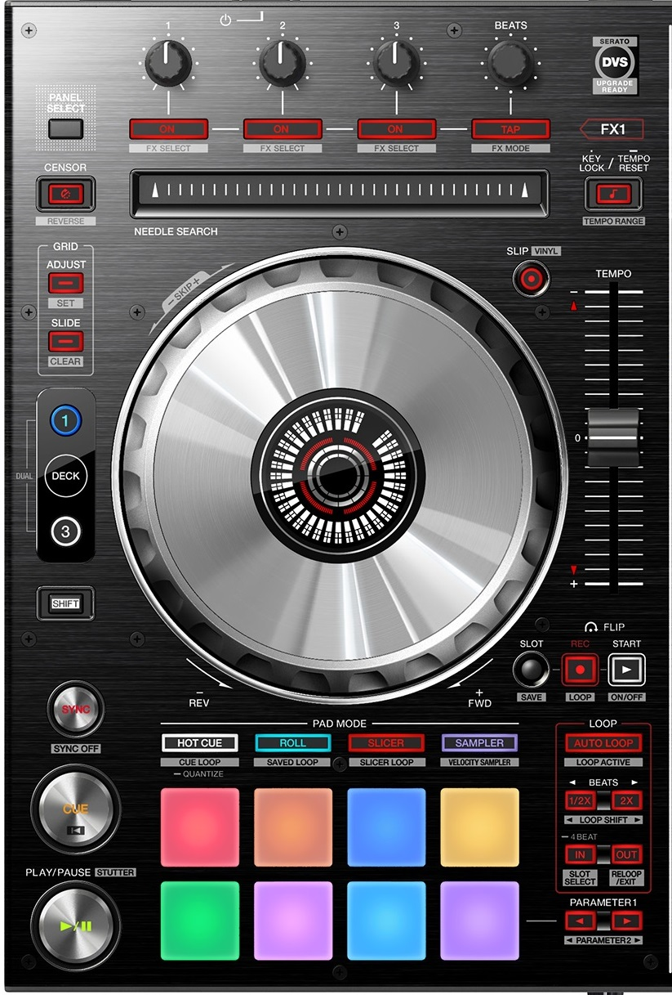
DDJ-SX2/SZ: Pad modes
HOT CUE
(Cancel JogFX)
PAD FX
(twice = cycle)
MACRO FX (twice =cycle)
JOG FX
KEYBOARD
BEATJUMP / LOOPS
SLICER
REMIX DECKS

Slide 3
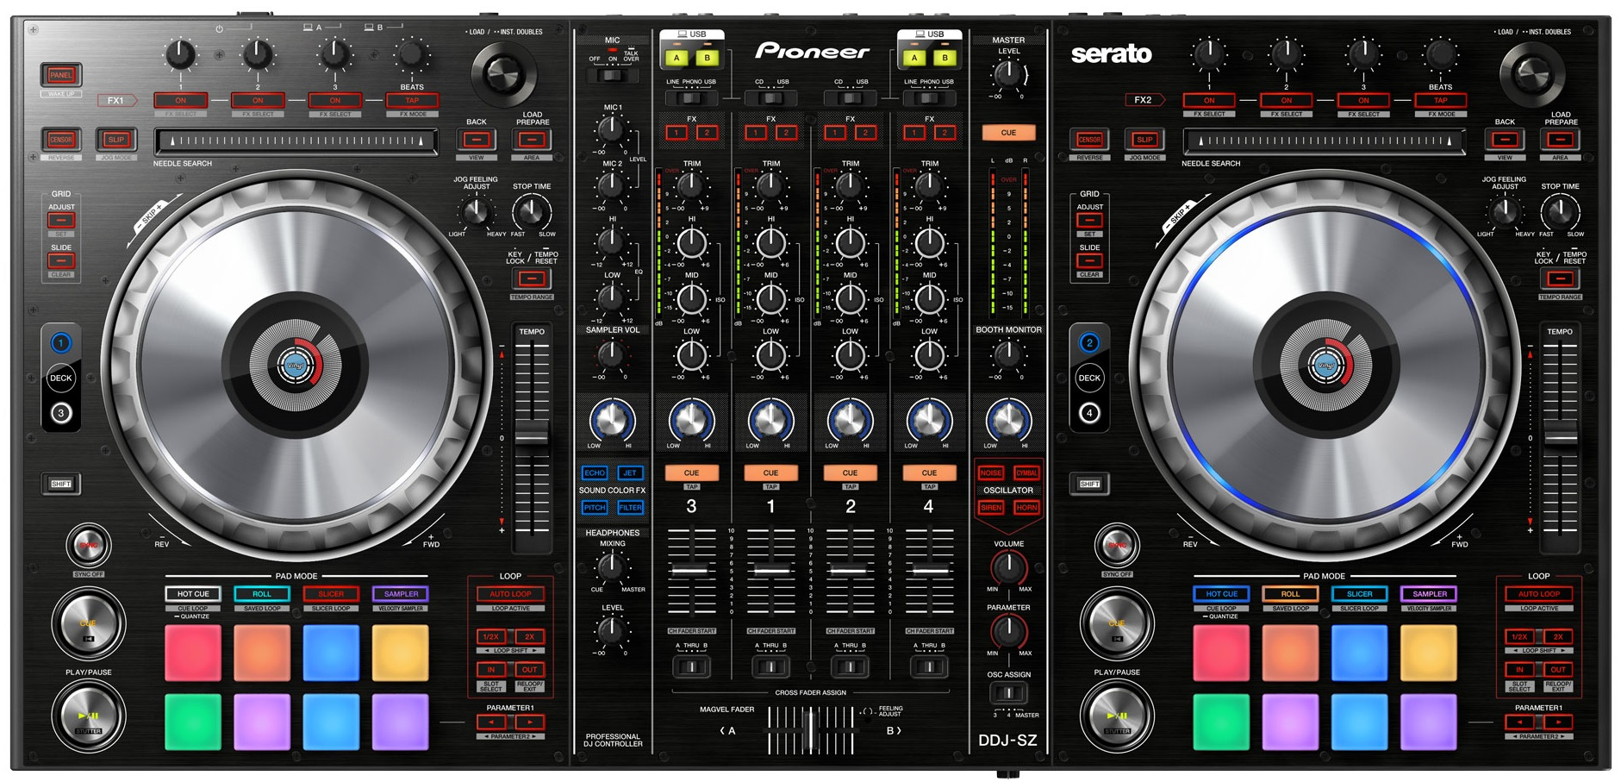
DDJ-SZ: General overview - Deck
Dry Wet / Toggle all FX units
Select FX
Turn FX off
Layout Classic / Parallel
List Browse / Tree Browse Zoom / Preview player
TP3 Slip Reverse
Preview Player
(using browser)
Slip / CDJ mode)
BPM Slide / Set Marker / Auto
Only Browser (toggle)
BPM Adjust / Reset Marker / Lock
Keylock / 6%->10%->16%->100%
Second shift
/ Layout change
JogFX / Quick Search
CDJ / Grid Adjust
Main shift
Loop recorder functions
Sync Force / Sync Off / Master
4-beat Loop / Active Loop / Move 1-beat
Track begin
LoopSize
In/Out / LoopSize / LoopAdjust
TurnTable FX / Vinyl Stop / Release FX
BeatJump / Jump Size / Move by 1

Slide 4

DDJ-SX2: General overview - Deck
Dry Wet / Toggle all FX units
Select FX
Layout Classic / Parallel
Turn FX off
TP3 Slip Reverse
Keylock / 6%->10%->16%->100%
BPM Slide / Set Marker / Auto
Slip / CDJ mode)
BPM Adjust / Reset Marker / Lock
JogFX / Quick Search
CDJ / Grid Adjust
Second shift
/ Layout change
Main shift
Loop recorder functions
Sync Force / Sync Off / Master
4-beat Loop / Active Loop / Move 1-beat
LoopSize
Track begin
In/Out / LoopSize / LoopAdjust
TurnTable FX / Vinyl Stop / Release FX
BeatJump / Jump Size / Move by 1

Slide 5
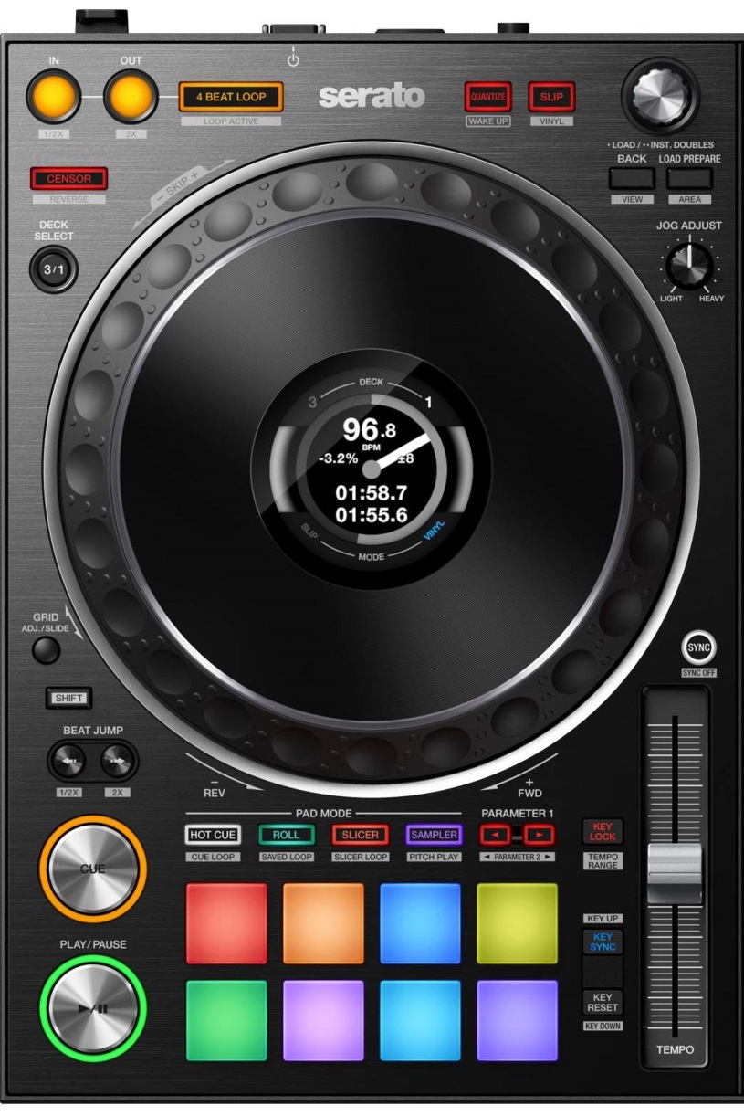
DDJ-1000SRT: General overview - Deck
Quantize + Snap (toggle)
CDJ mode (per deck)
4-beat Loop / Active Loop / Move 1-beat
List Browse / Tree Browse Zoom / Preview player
LoopSize / MoveSize / BeatJump
Only Browser (toggle)
TP3 Slip Reverse
Preview Player
(using browser)
Layout change
JogFX / Quick Search
CDJ / Grid Adjust
Second shift
Main shift
Sync Toggle / Sync Off / Master
BeatJump / Jump Size/ Move by 1
Track begin
Keylock / 6%->10%->16%->100%
Vinyl Stop / Release FX
BPM Slide / Set Marker / Auto
Key reset / BPM Adjust Reset Marker / Lock

Slide 6
DDJ-SZ General overview - Mixer
Manual FX routing
JogFX+MacroFX DryWet
MacroFX / MixerFX
ColorFX (hardware)
MixerFX (TBD)
Keep at Zero!
Beat FX Dry/Wet
Keep at “4”

Slide 7
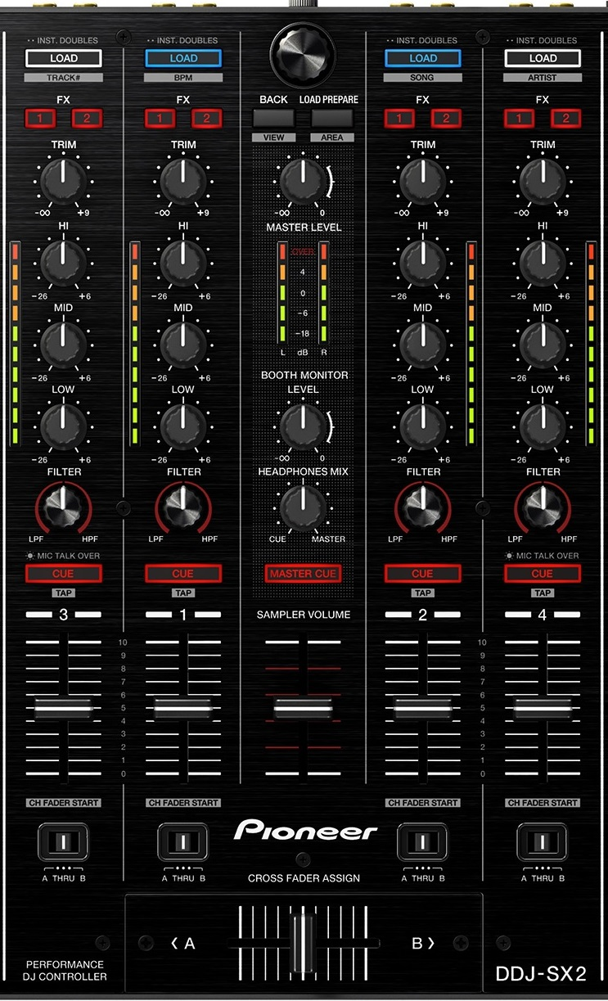
DDJ-SX2: General overview - Mixer
List Browse / Tree Browse Zoom / Preview player
Only Browser (toggle)
Preview Player
(using browser)
MacroFX / MixerFX
JogFX+MacroFX DryWet

Slide 8

DDJ-1000SRT: General overview - Mixer
Pitch (HW)
Dub Echo (HW)
Noise (HW)
MacroFX / MixerFX
Filter (HW)
FX Parameter / Single+Group
Pioneer FX
JogFX+MacroFX DryWet
FX Routing
Dry Wet /
FX Parameter
FX ON+OFF

Slide 9
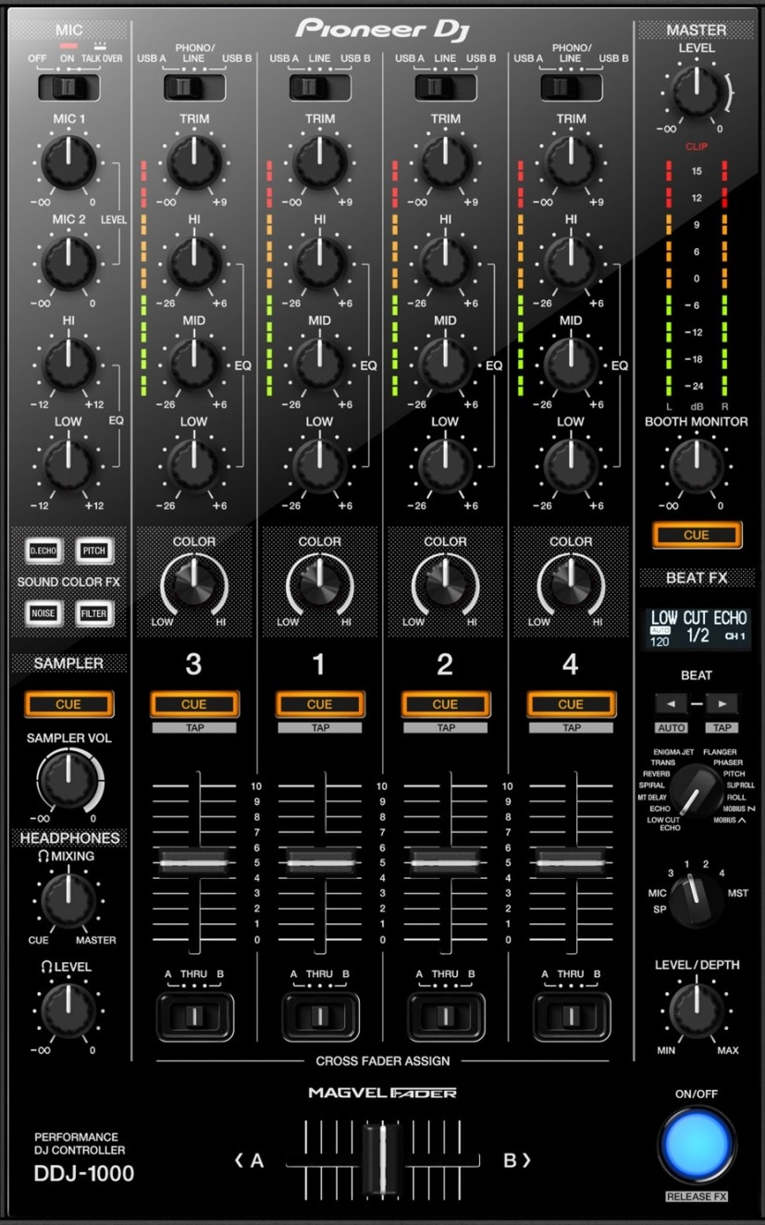
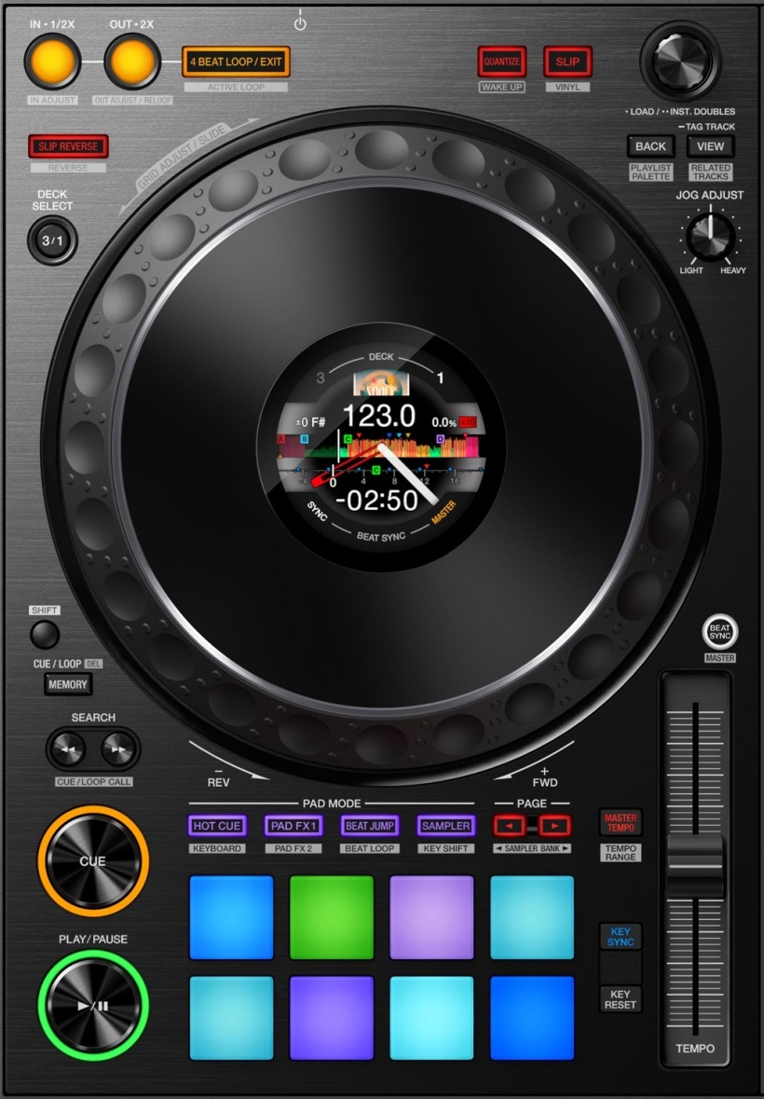
DDJ-1000: MixerFX and UserFX
Dlb delay
T. Gater
Noise
Both mixerFX + MacroFX
Regular: FX Parameter
+shift: Single Group
UserFX Pioneer effects (MST)
Crush
Filter
Dry/Wet MacroFX + JogFX
FX Routing
Regular: DryWet
+shift: FX Parameter
MacroFX (twice=cycle)
FX ON+OFF

Slide 10
DDJ-SZ: MixerFX and UserFX
COLORFX hardware
Dlb delay
Noise
T. Gater
Crush
Filter
Keep at zero!
MacroFX (twice=cycle)
Dry/Wet BeatFX
Keep at “4”

Slide 11

DDJ-1000/SRT: Loop Section
(DDJ-SX2/SZ)
Regular: Loop In
Loop Engaged: 1/2x
Regular: Loop Out
Loop Engaged: 2x
4-beat Loop
Loop Exit
Whole loop adjust +memory: Loop In adjust
Loop out adjust mode
Loop activate
+
+
+
Select 1/2x
Select 2x
AutoLoop (selected size)
+
+
Select 1/2x
Select 2x

Slide 12
DDJ-1000/SRT: BeatJump Section
(DDJ-SX2/SZ)
Select Size 1/2
Select Size 2x
Beatjump left Loop move left
Beatjump right Loop move right
+
+
Beatjump 1-beat left Loop 1-beat left
Beatjump 1-beat right Loop 1-beat right
+
+

Slide 13

DDJ: Sync Section
TRAKTOR MODE
SERATO MODE
ELASTIC GRID MODE
Preferences / Transport
BeatSync
Tempo Sync
BeatSync
Toggle ON/OFF
Sync On
Sync On
Sync On
Sync Off
+
Set master deck
+
Sync Off
+
+
Toggle between 3x sync modes

Slide 14
DDJ-1000/SRT: Deck layout
(DDJ-SX2/SZ)
Toggle 2-deck / 4-deck view
(Double Tap)
+
Toggle Parallel / Classic view
+
Enable/ disable layout change
+

Slide 15
ALL DDJs: Browser
Turn: Browse List Press: Load Track
(BROWSER)
Load+Start Preview player
Only browser
Turn: Scroll Tree Press: Expand Folder
(BROWSER TREE)
+
Scroll Favorites
Goto Collection
Turn: Seek Preview player Press:
(PREVIEW PLAYER)
+
Load/Unload Preview player
Turn: Zoom deck Press: Zoom reset
(DECK ZOOM)
+

Slide 16
DDJ-1000/SRT: Transport
(DDJ-SX2/SZ)
Main shift
Second shift
regular: Cue
+shift: Move to font
regular: Pause
+shift: Vinyl quick stop
+memory: Vinyl long stop
+shift: Unload deck

Slide 17

DDJ-1000/SRT: Beatgrid
+shift: BPM set
+Jog: grid slide
+KeyReset: BPM Auto
Regular: key reset
+shift: BPM delete
+Jog: grid adjust
+KeySync: Analysis Lock
DDJ-SX2/SZ: Beatgrid

Slide 18
DDJ-1000: Mapping Settings
+
+
Toggle Traktor/Serato sync mode
+
+
Toggle Monitor cue external/internal
+
Screens Reset
+
Cross-fader curve select
+
+
Deck Unload
+
Crossfader Curve Adjust

Slide 19
DDJ-1000: Pad modes
HOT CUE
(Cancel JogFX)
PAD FX
(twice = cycle)
MACRO FX (twice =cycle)
JOG FX
Cycle pages
Select page
KEYBOARD
BEATJUMP / LOOPS
SLICER
REMIX DECKS
Most modes have sub-pages:
Press “mode” to cycle the top 2 pages
Press “<” to cycle all pages one by one
Press “>” to select a specific page
Press “shift” to select a specific page

Slide 20
DDJ-SZ/SX2: Pad modes
HOT CUE
(Cancel JogFX)
PAD FX
(twice = cycle)
MACRO FX (twice =cycle)
JOG FX
KEYBOARD
BEATJUMP / LOOPS
SLICER
REMIX DECKS

Slide 21
ALL DDJs mode #1: HotCues
HOTCUE
Cue 1
Cue 2
Cue 3
Cue 4
Cue 5
Cue 6
Cue 7
Cue 8
Use shift to delete hot cues
Hotcues move temporary cue as well

Slide 22
ALL DDJs mode #2: PadFX and Rolls
MAIN PAGES:
EXTRA PAGES:
Rolls
PadFX 2
Roll 1/8
Roll 1/4
Roll 1/2
Roll 1/1
Delay #1
Delay #2
Delay / BeatSlicer
Flanger Flux
Roll 1/8
(NQ)
Roll 1/4
(NQ)
Roll 1/2
(NQ)
Roll 1/1
(NQ)
Lofi / Slicer #1
Lofi / Slicer #2
BeatSlicer
Release FX (toggle)
PadFX 1
PadFX 3
Gater #1
Gater #2
Gater #3
Peak Filter
Filter Pulse
LaserSlicer
Bass-O-Matic #1
Bass-O-Matic #2
Beat
Masher #1
Beat
Masher #2
Zzzurp
Release FX (toggle)
Bouncer / EventH
Bouncer
EventH
Release FX (toggle)
Use mode button to cycle top two pages
Use “<“ arrow to cycle all pages
Use “>” or “shift” to select a specific page

Slide 23
ALL DDJs mode #3: MixerFX and MacroFX
MAIN PAGES:
Dlb delay
T. Gater
Macro FX1
Noise
Both mixerFX + MacroFX
MacroFX: WormHole
MacroFX: PolarWind
MacroFX: FlightTest
MacroFX: LaserSlicer
Crush
Filter
BeatFX: Delay T3
BeatFX: Flanger
BeatFX: Reverb
Toggle On/OFF
Dry/Wet MacroFX + JogFX
MacroFX2
MixerFX
Event Horizon
Zzzuurp
Dark
Matter
Bass O Matic
MixerFX: Dbl Delay
MixerFX: TimeGater
MixerFX: Crush
MixerFX: Noise
Strrretch (Slow)
Strrretch (Fast)
Granu Phase
Toggle On/OFF
Filter
Use mode button to cycle top two pages
Use “<“ arrow to cycle all pages
Use “>” or “shift” to select a specific page

Slide 24

ALL DDJs mode #4: JogFX
Jog FX
JOG FX
Beatmasher Digital filter Gater
Beatmasher Filter Reverb
EventHorizon
(none) Gater
Gater Beatmasher Reverb
Flanger (None) Gater
Beatmasher Peak filter Gater
FormatFilter Peak filter Flightest
Enter jogFX mode on mode4 (jog will blink)
Touch jog to apply FX
Turn jog to change FX
Release jog to stop FX
Sampler volume to Dry/Wet
Call “hotcues” to cancel jogFX (=scratch mode)

Slide 25
ALL DDJs #5: Tone Play
TONE PLAY
TONE PLAY
+4
+5
+6
+7
+12
= 0
Inc
Dec
= 0
+1
+2
+3
+8
+9
+10
+11
Use shift to choose between 3x modes:
TONE PLAY
N/A
Cue And Play mode
Cue mode
Play mode
Key reset

Slide 26
DDJs mode #6: BeatJumps and Loops
BEATJUMP
LOOP
Jump -1
Jump +1
Jump -4
Jump +4
Loop 4
Loop 2
Loop 1
Loop 1/2
Jump -8
Jump +8
Jump -16
Jump +16
Loop 4
Loop 8
Loop 16
Loop 32
Use “<“ arrow to select beatjump mode
Use “>” arrow to select loop mode

Slide 27
ALL DDJs mode #7: Slicer
SLICER
Slicer #1
Slicer #2
Slicer #3
Slicer #4
Slicer #5
Slicer #6
Slicer #7
Slicer #8
Use shift to choose between 3x modes:
SLICER
8 slices whole
16 slices odd
16 slices even

Slide 28
ALL DDJs mode #8: Sampler
SAMPLER
Cell #1
Cell #2
Cell #3
Cell #4
Cell #5
Cell #6
Cell #7
Cell #8
Use shift to mute / Toggle 1-shot
SAMPLER
Mute #1
Mute #2
Mute #3
Mute #4
Loop / 1-shot #1
Loop / 1-shot #2
Loop / 1-shot #3
Loop / 1-shot #4

